Slide 1
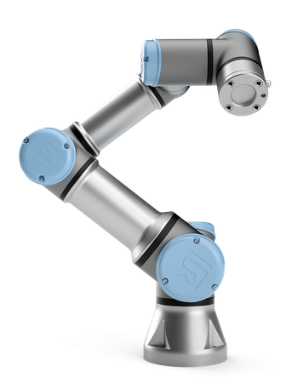
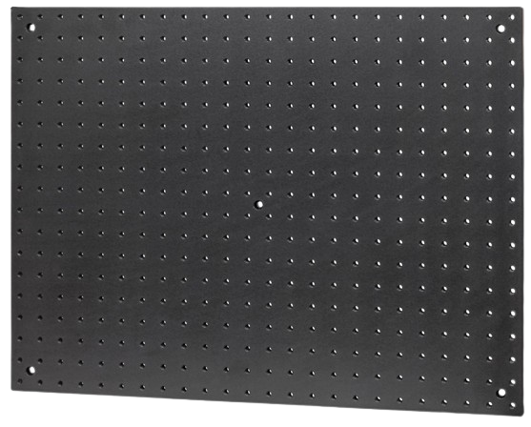
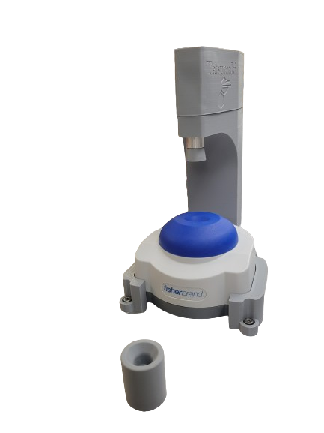
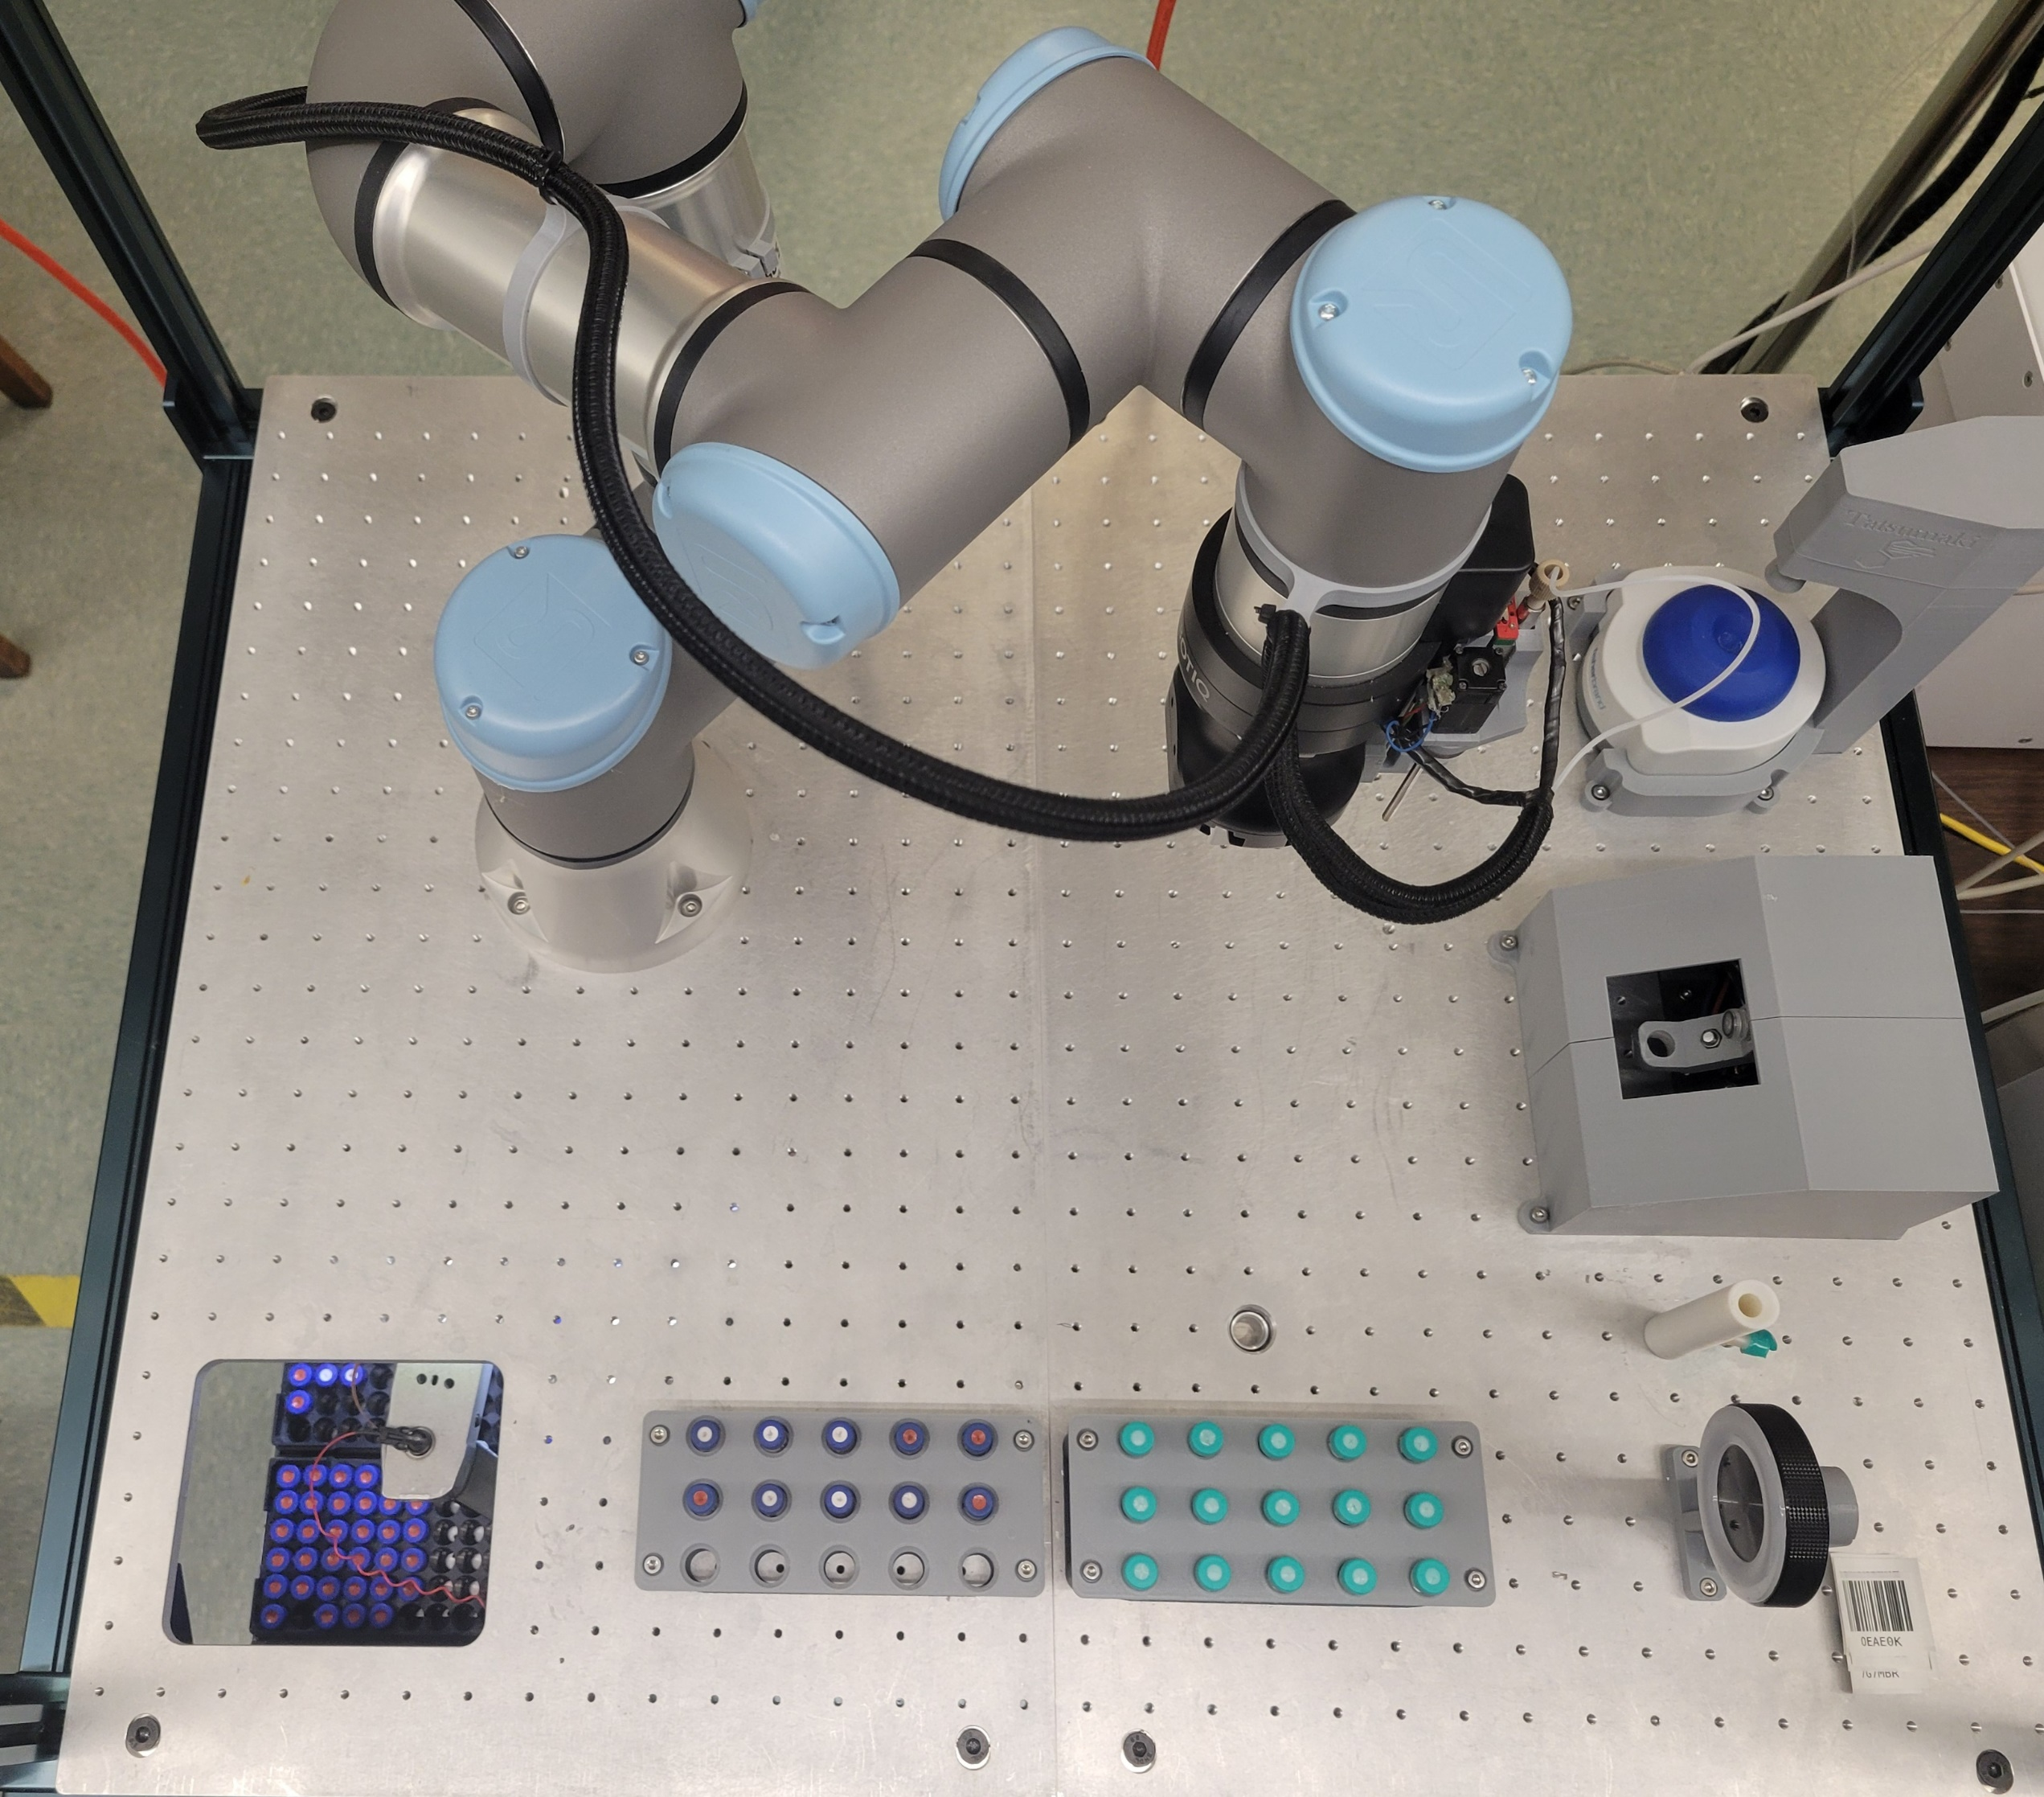
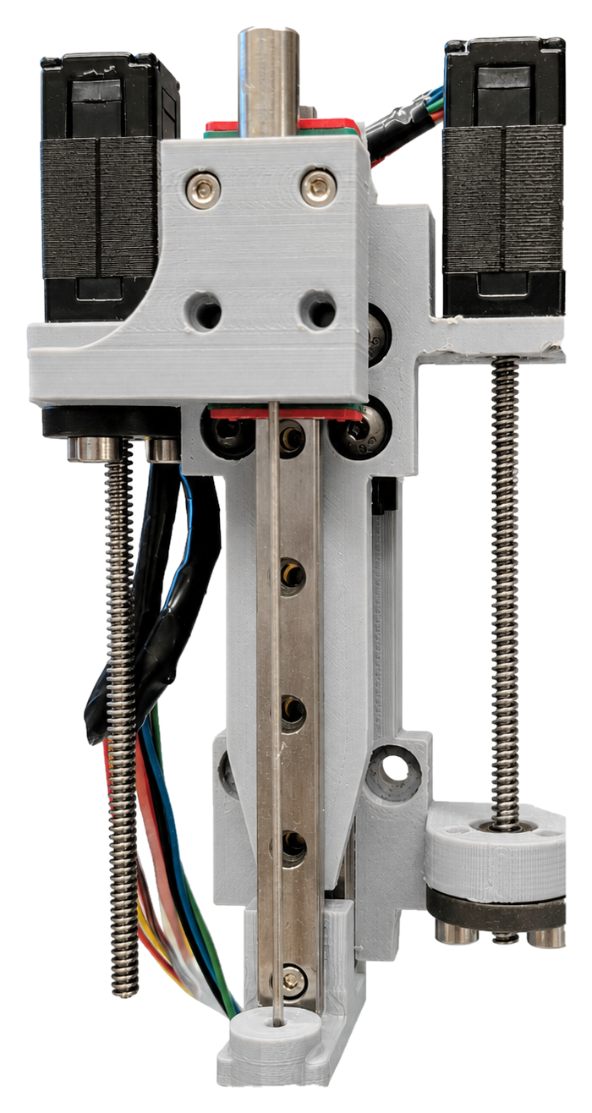
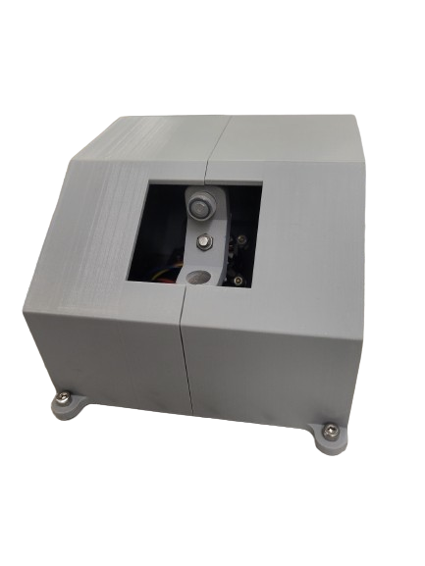
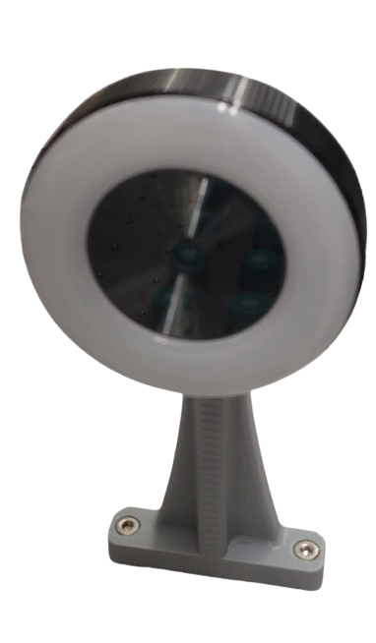
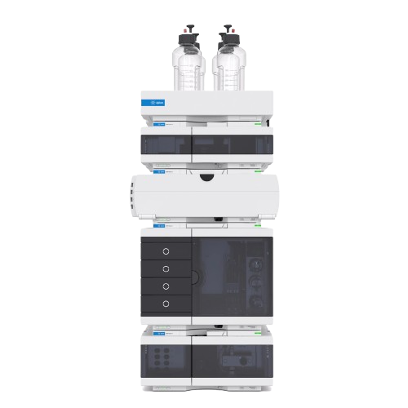
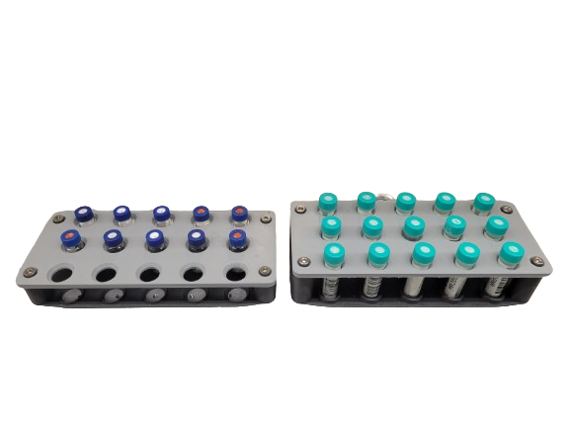
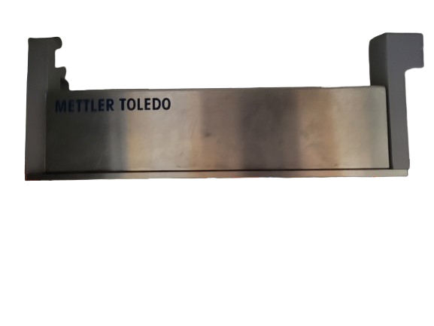
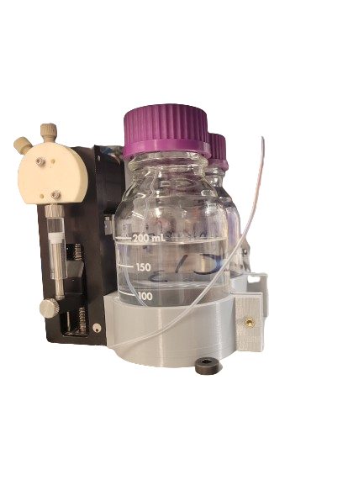

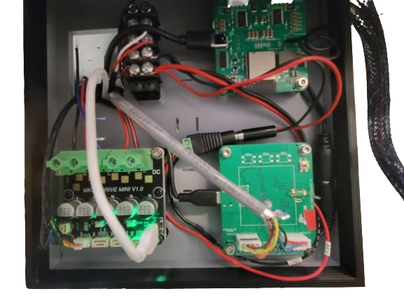





Using Automation to Provide High-Quality
Analytical Data in Drug Checking and Point of Care Services
Clark Zhang¹, Matthew E. Reish¹, Rebekah Greenwood¹, Guy Swain¹, Rebecca Hickman¹, Sara Guzman¹ and Jason E. Hein¹⁻³
Each year, there are over 10,000 cases of overdose in Vancouver¹, many due to drug contamination. In response to the current overdose health crisis, numerous drug-checking centers have been set up, often using test strips to identify compounds and infrared spectroscopy for quantification. Despite governmental efforts, access to advanced methods like high-performance liquid chromatography (HPLC) remains limited. As operations of these technologies require specialized personnel, we can improve accessibility to these systems by integrating automation.
We are developing a robotic arm system to prepare, analyze, quantify, and upload the data of a sample within 15 minutes to inform users, ultimately reducing overdose risk.
Software
All functions required for operation are coded in Python. Relevant code can be found on the Hein Lab GitHub.
UR3e robot with grippers to operate vial transfers between components
Design Verification
1
3/8” aluminum platform with machined M4 holes
3D-printed housing for a stepper motor-activated Fisher vortexer
Calibration curves were autonomously generated by the robot. Shown below are the curves for caffeine and acetaminophen.
2
3
Liquid Handler made with chemical-resistant plastic designed to precisely dispense and aspirate samples
Caffeine calibration curve
4
User input required
Custom BLDC motor centrifuge operated by an O-Drive motor controller spinning at a maximum of 12000 rpm.
Pre-run
67.5 cm
Vial tared and barcode applied
Vial is loaded with solid sample
Vial loaded into
vial tray
5
Sample Preparation
6
Acetaminophen calibration curve
Dilute sample
with solute
Scan and
weigh vial
Prime needle
Barcode reader designed with a Razer webcam and 3D-printed mount
Vortex and centrifuge
Transfer stock solution to
HPLC vial and dilute
Run sample through HPLC
9
8
7
Analysis
Agilent HPLC for substance analysis
Upload data
Correlate to mass % using calibration curve
Extract relevant area data
Mettler-Toledo balance mounted underneath platform using 3D-printed legs
3D-printed vial trays designed to house 15 HPLC vials and centrifuge vials
Future Work
In the next phase of our project, we will expand our analytical library to include a wider range of substances, including methamphetamine, heroin, cocaine, and fentanyl.
Additionally, we will develop a program to automatically upload results to our website where individuals can access their analysis data by entering their vial ID. This feature will provide timely and accurate information, further enhancing the safety and awareness of drug users.
A Deeper Look
Hidden Components
Scan the QR code
for an annotated
demonstration video
3D-printed electronics box to house stepper motor and BLDC motor controllers
Syringe pump and solvent and waste bottle housing behind the HPLC
References
BC Emergency Health Services, http://www.bcehs.ca, 2023
Affiliations
Department of Chemistry, The University of British Columbia, 2036 Main Mall, Vancouver
Acceleration Consortium, University of Toronto, 700 University Ave suite 1001, Toronto
Department of Chemistry, University of Bergen, Allégaten 41, 5007 Bergen, Norway

Slide 2
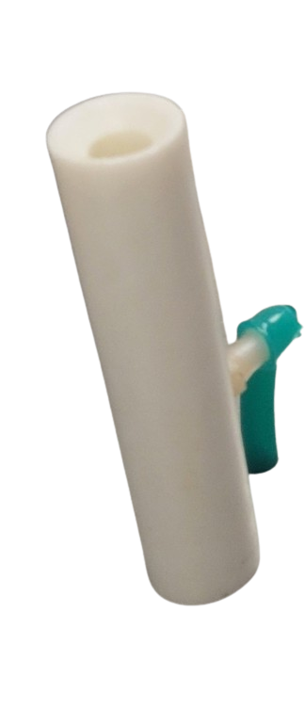
Using Automation to Provide High-Quality
Analytical Data in Drug Checking and Point of Care Services
Clark Zhang¹, Matthew E. Reish¹, Rebekah Greenwood¹, Guy Swain¹, Rebecca Hickman¹, Sara Guzman¹ and Jason E. Hein¹⁻³
Each year, there are over 10,000 cases of overdose in Vancouver¹, many due to drug contamination. In response to the current overdose health crisis, numerous drug-checking centers have been set up, often using test strips to identify compounds and infrared spectroscopy for quantification. Despite governmental efforts, access to advanced methods like high-performance liquid chromatography (HPLC) remains limited. As operations of these technologies require specialized personnel, we can improve accessibility to these systems by integrating automation.
We are developing a robotic arm system to prepare, analyze, quantify, and upload the data of a sample within 15 minutes to inform users, ultimately reducing overdose risk.
Software
All functions required for operation are coded in Python. Relevant code can be found on the Hein Lab GitHub.
UR3e robot with grippers to operate vial transfers between components
Design Verification
1
3/8” aluminum platform with machined M4 holes
3D-printed housing for a stepper motor-activated Fisher vortexer
Calibration curves were autonomously generated by the robot. Shown below are the curves for caffeine and acetaminophen.
2
3
Custom BLDC motor centrifuge operated by an O-Drive motor controller spinning at a maximum of 12000 rpm.
Caffeine calibration curve
4
Pre-run
User input required
5
Needle wash station made with chemical-resistant plastic designed to clean the needle between runs
Vial tared and barcode applied
Vial is loaded with solid sample
Vial loaded into
vial tray
67.5 cm
Sample Preparation
6
Acetaminophen calibration curve
Dilute sample
with solute
Scan and
weigh vial
Prime needle
Barcode reader designed with a Razer webcam and 3D-printed mount
Vortex and centrifuge
Transfer stock solution to
HPLC vial and dilute
Run sample through HPLC
9
8
7
Analysis
Agilent HPLC for substance analysis
Upload data
Correlate to mass % using calibration curve
Extract relevant area data
Mettler-Toledo balance mounted underneath platform using 3D-printed legs
3D-printed vial trays designed to house 15 HPLC vials and centrifuge vials
Future Work
In the next phase of our project, we will expand our analytical library to include a wider range of substances, including methamphetamine, heroin, cocaine, and fentanyl.
Additionally, we will develop a program to automatically upload results to our website where individuals can access their analysis data by entering their vial ID. This feature will provide timely and accurate information, further enhancing the safety and awareness of drug users.
A Deeper Look
Hidden Components
Scan the QR code
for an annotated
demonstration video
3D-printed electronics box to house stepper motor and BLDC motor controllers
Syringe pump and solvent and waste bottle housing behind the HPLC
References
BC Emergency Health Services, http://www.bcehs.ca, 2023
Affiliations
Department of Chemistry, The University of British Columbia, 2036 Main Mall, Vancouver
Acceleration Consortium, University of Toronto, 700 University Ave suite 1001, Toronto
Department of Chemistry, University of Bergen, Allégaten 41, 5007 Bergen, Norway

